Slide 1



FALL OPEN HOUSE
Office of Financial Aid
Providence College
October 19, 2019

Slide 2

agenda
Guiding Principles of Financial Aid
What Forms to Complete
Who Should File a FAFSA/CSS Profile?
How is Financial Aid Calculated?
Determining Financial Need
What to Expect in a Financial Aid Award
Sources of Financial Aid
Outside Scholarships/Alternative Financing
Can My Award Change Each Year?
Comparing College Award Letters
Estimating Next Four Years
Current Costs
Important Dates and Deadlines
Financial Aid Timeline
Communication
Summary/Contact Us

Slide 3
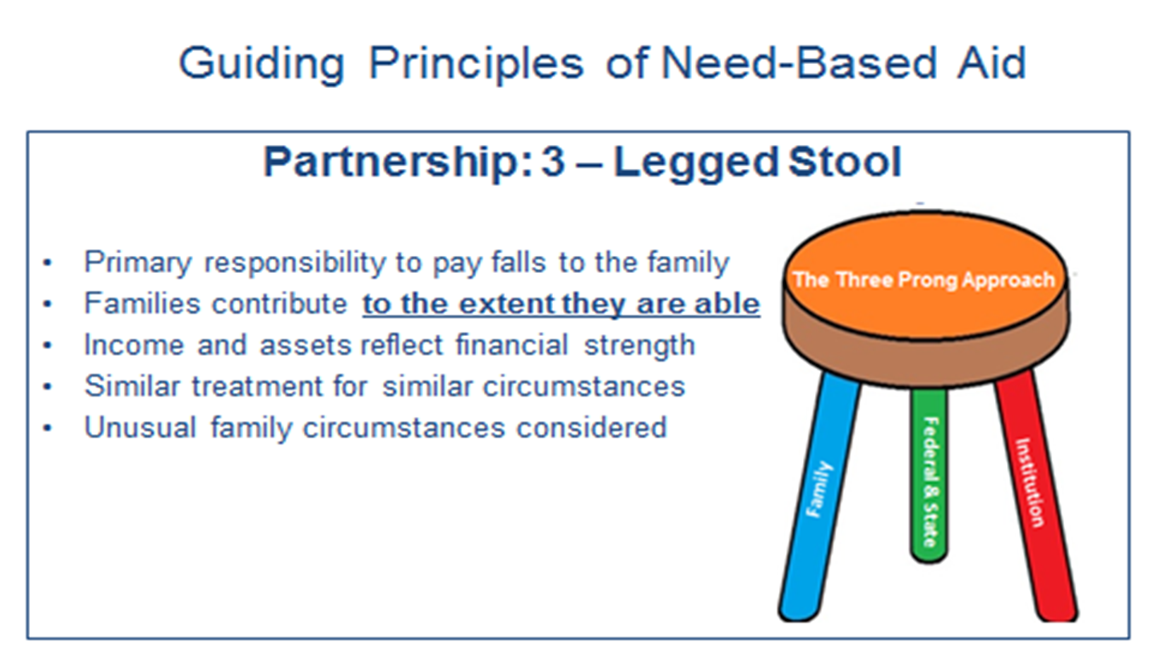
Guiding Principles

Slide 4
What forms do I need to complete?
FSA ID
This is your electronic signature for FAFSA and all government loans
Get it at - www.fsaid.ed.gov!
Get this before you start the application process!
FAFSA
Application is for federal funding (federal student loans and Pell Grants)
Free to file
Get it at - www.fafsa.ed.gov
Use the Data Retrieval Tool from IRS
CSS Profile
Application is for institutional funding (Providence College need-based funding).
Get it at - www.collegeboard.org
Initial application costs $25, $16 for each additional school
We do not participate in IDOC. All documents should be sent directly to the office
We do not require the Non-Custodial Parent’s CSS Profile

Slide 5
Who should file the Fafsa/CSS Profile
EVERYONE – We encourage all families to file for financial aid.
  If your family’s financial situation changes during the year, the student might now be eligible for financial aid if the forms were completed prior to the deadline.
  Do not make the assumption you are not eligible for financial aid.
  Financial Aid can change each year – if there is a change in household income, number of children enrolled in college, household members, etc….your financial aid can change. FILE EVERY YEAR!
Don’t wait until you find out acceptance to apply for aid!
  Process is done concurrently to admission process, not after!
  Get your FSA ID before you start to apply
  Make sure documents are received by our office by the deadlines

Slide 6
What if I make a mistake?
  Both forms can be corrected, just in different ways!
  FAFSA
    Log back in using your FSA ID and make changes
    Corrections will be sent to all schools listed on the form
  CSS Profile
    Cannot be updated on the College Board website
    Print out your summary pages
    Outline/initial changes
    Send directly back to the school
    Based on the change, school may ask for documentation

Slide 7


How is financial aid Calculated?
Direct costs typically charged by the college:
Tuition and fees
Cost of meal plans on campus
+
Cost of living in dorms
+
Indirect costs that may not be charged by the college:
Allowance for
personal expenses and a few meals out
Allowance for
books and supplies
Allowance for
transportation
+
+
Notes:
PRESENTER NOTE: Please share how your institution takes into account the various costs associated with attending your college/university when distributing aid.
For Example:
Tuition: actual
Fees: mandatory
Room: common
Board: average
Books
Supplies: historical
Transportation: two round trips
Commuting: # of days on campus
Personal: average & historical

Slide 8
How is financial aid calculated? (CONT.)
*Note: This is not the same as the student’s bill or the amount a family will actually pay for the student to attend college.
**Net Price may be different from the financial need. We are unable to fill 100% of the financial need a family may demonstrate so there may be unmet need that a family will have to finance or pay.
Total Cost of Attendance
Expected Family Contribution (EFC)*
Financial Need
Notes:
“Financial need” determines if the student has eligibility for need-based aid.
Families should be aware that demonstrated need may not be met 100%
The Expected Family Contribution (EFC) is calculated using the information provided on the Free Application for Federal Student Aid (FAFSA). Using a standardized formula (Federal Methodology) the family’s ability to contribute (EFC) is established for the purpose of determining eligibility for financial aid.
Feel free to explain how the EFC can change from college to college. For example, professional judgment and updated information.

Slide 9
How is financial aid calculated? (CONT.)
The Expected Family Contribution (EFC) is the number that is used to determine students’ eligibility for federal student financial aid.
  IS a measure of parent’s capacity over time to absorb educational costs
  IS NOT an estimate of ‘extra’ cash available
Many states also use the EFC to determine eligibility for state aid; institutions may also use the EFC to determine eligibility for institutional aid.
This number is calculated from the results of the financial information the student and family provide in the Free Application for Federal Student Aid (FAFSA).
The student's EFC is reported on the Student Aid Report (SAR).

Slide 10
Determining Financial Need
Federal (FAFSA)
COA $67,578
FM EFC - 16,200
--------------------------------
FM Need $51,378
Note: If the EFC is greater than the COA, than the family has “no need”.
Institutional (PROFILE)
COA $67,578
IM EFC - 23,600
-----------------------------------
IM Need $43,978
Note: Inst. Need usually less as it includes a more well-rounded picture of a family’s financial strength.

Slide 11
What to expect in a financial aid award?
Gift Aid (Merit vs. Need)
  Grants and Scholarships
  Money that doesn’t have to be paid back
  Merit- determined by Admission Office based on high school performance
  Athletic- determined by the coaching staff based on athletic ability
  Need- based on a family’s demonstrated financial need through the FAFSA/CSS Profile efcs.
Loan Aid
  Borrowed Money
  Low interest rates (Fed Loans 4.53% currently)
  Repayment after graduation for students
Employment Aid
  Wages earned from a job
  Minimum wage $10.50/hr

Slide 12

Sources of Financial Aid
Federal Government
  Pell Grant: EFC < 5,576, max = $6,195
  SEOG: Pell eligible, max = $4,000
  Stafford Loan (subsidized)
    Freshmen = $3,500
    Sophomores = $4,500
    Juniors and Seniors = $5,500
    All can get $2,000 (unsubsidized)
  Work Study
    Jobs available are on and off campus
    Students earn a check, money awarded does not come off the bill
    Pell figures reflect 2019-2020 academic year scheduled awards

Slide 13

Outside Scholarships
Beware of “for cost” searches -- especially those that guarantee to find scholarships or they’ll refund your money
If someone says “you've won a scholarship” and you don't remember entering the contest or submitting an application, be suspicious
Watch for phrases like “everybody is eligible” or “we apply on your behalf”
Check for typing and spelling errors, a box # for a return address, no telephone # listed
Check websites like Fastweb.com or the College Board Website
If you receive an outside scholarship it would first go to unmet need and loans before it would affect your grant.

Slide 14

Alternative Financing
Monthly Payment Plan
  Through Nelnet (www.afford.com )
  Payments spread over 10 months
  $85 application fee
Home Equity Loan (tax benefits)
Parent Loan
Alternative Student Loan (need co-signer)

Slide 15
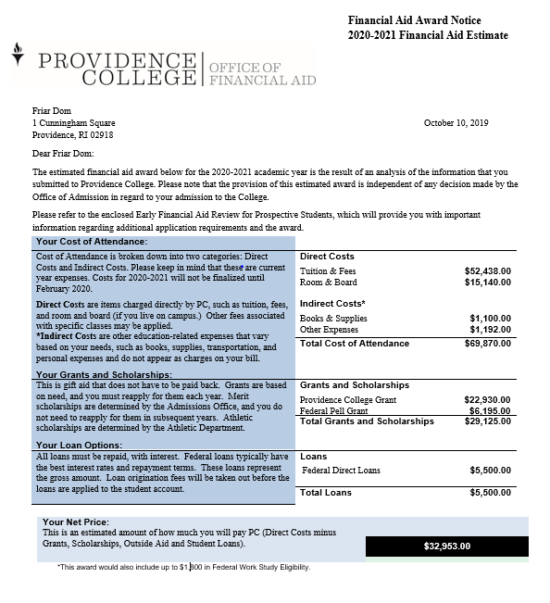
Sample Financial Aid Letter

Slide 16
Can my award change from year to year?
YES!
NEED BASED AWARDS:
    Need-based awards are determined by Expected Family Contribution (EFC)
      Total family income, assets, number in household, number in college, business/home equity all factor into how much a family’s “ability” to pay is determined.
    If my income and assets are the same, how could my award change?
      Number of people in the household – divorce, marriage, sibling moved out, etc…
      Number of enrolled in college – sibling graduates or terminates enrollment
      Started or closed a business – business value can affect need
      Purchased or sold a home – home equity increases or decreases
  MERIT BASED AWARDS:
    Is the merit award one-time or renewable?
      It is renewable*: Merit awards can change if the terms of the award are not met (GPA or other requirements – know the terms of your award)

Slide 17
Why Packages Differ from School to School
FAFSA used to determine Federal Eligibility
CSS Profile used to determine Institutional Eligibility
  Includes home equity, adds back business losses, etc. Gives more well-rounded view of a family’s finances
Student has different spot in the applicant pool from school to school-Merit awards
Cost of schools different
School using Federal EFC vs. Institutional EFC
School’s use of Institutional Methodology is different therefore different Institutional EFC
Some schools have more money to give out than others
Make sure you compare from school to school!

Slide 18
How can I best estimate the next 4 years?
Ask each school if the award is guaranteed all four years or is dependent on FAFSA/CSS Profile, etc.
Usually, merit awards are guaranteed (contingent on academic performance)
Need-based are usually dependent on the FAFSA/CSS Profile EFC each year
Enter information in the net price calculator to see what aid will be if the number in college changes or if you estimate an increase to your income in the future
Don’t be afraid to call the Financial Aid Office and try to map out the next four years with them

Slide 19
Never rule out college because of cost
Net Price Calculators: provide an estimate of financial aid eligibility and remaining costs (available on all schools’ websites!)
Apply to a “safety school” for financial aid: Add a school to your list that is not only a “safety school” academically, but financially affordable
Compare all awards before deciding: Do not make a financial commitment until you have compared all financial aid awards. Most deposits are non-refundable!
Involve the student in the financial process: Some student loans will be the student’s responsibility to repay, they should be aware of what they are borrowing

Slide 20

2019-2020 Costs
2020-2021 costs have not been finalized yet
Current DIRECT COSTS for Resident in 2019-2020 is:
  Tuition: $52,438
  Room: $8,730 (traditional dorm)
  Board: $6,410 (unlimited meal plan)
  TOTAL: $67,578
INDIRECT COSTS
  Books: $1,100 (estimate)
  Miscellaneous: $1,052
  *Health Insurance:$1,559
    *Only for students who are not covered by parent’s plan

Slide 21
Important dates and deadlines
Early Decision I | Early Action | Early Decision II | Regular Decision
2020-2021 FAFSA (due Nov. 1st) | 2020-2021 FAFSA (due Nov. 15th) | 2020-2021 FAFSA (due Jan. 15th) | 2020-2021 FAFSA (due Feb. 1st)
2020-2021 CSS Profile (due Nov. 1st) | 2020-2021 CSS Profile (due Nov. 15th) | 2020-2021 CSS Profile (due Jan. 15th) | 2020-2021 CSS Profile (due Feb. 1st)
2018 Business Tax Information (due Nov. 8th) | 2018 Business Tax Information (due Dec. 1st) | 2018 Business Tax Information (due Jan. 15th) | 2018 Business Tax Information (due Feb. 15th)
FAFSA/CSS Profile are both available October 1, 2019
Documents must be IN to the office by these dates. Please allow enough processing time
Business Tax Information = (Schedule C, E, F, K-1, 1120s, 1120, 1065P)
We WILL collect personal taxes and W2s from student/parent to finalized, but will offer a tentative award without them

Slide 22
Timeline
October – FAFSA and CSS Profile are available
December – Early Decision I acceptances and awards are available
January – Early Action acceptances and awards are available
            Early Decision I deposits due
February- Early Decision II acceptances and awards are available
            Early Decision II deposits due
March/April – Regular decision acceptances and awards are available
May 1 – Admission deposits due (Early Action/Regular Decision)!

Slide 23
Communication
We communicate to parents/students through email
Once enrolled, all communication goes only to the student
Follow us on Facebook!
Think about creating a family email solely for college/financial aid applications!
We hope to work with families to make this process as easy as possible.

Slide 24

summary
Fill out FAFSA/CSS Profile every year
Make sure you complete forms by our deadlines
  If not could be put on a waitlist for funds and are not guaranteed to receive institutional grants.
Don’t rule out schools based on what you “think” they may cost
Financial Aid Awards can change from school to school
Can always contact our office for assistance

Slide 25

Contact us!
Harkins 403
(Fourth floor)
Office of Financial Aid
Counselor-on-call every day to assist you!
401-865-2286
finaid@providence.edu
Find us on Facebook!

